Slide 1
GIS Project: Transportation Equity
Justin Crippen, Ashlee Day, Prateek Kakkar, Isaac Yescas

Slide 2
Background
People with disabilities are often forced to make difficult decisions about where they are able to live, work, and spend their time based on access to public services that are out of their control.
Access to reliable and accessible public transit is a fundamental part of ensuring that all people, especially those with disabilities, have equal access to opportunity.
By comparing where people with disabilities reside with the location of accessible public transportation options, we can better understand what gaps exist with regard to mobility
By adding in data comparing the location of affordable housing with census income data, we gain additional insight to equity disparities experienced by people with disabilities.
Notes:
Historically, transportation policy in the United States has disproportionately prioritized investment in transportation systems that favor personal vehicle ownership.
These trends have been shown as accurate in other major US cities, but a comprehensive study has not been published in regards to King County

Slide 3
Research Question and Hypothesis
Research Questions:
What areas of King County are people with disabilities likely to be concentrated in, and how is this influenced by factors such as income level, housing affordability, transit access?
How do people with disabilities navigate the trade off between housing costs and access to transportation?
Hypothesis
Affordable housing is likely to be congregated away from urban centers with sought after resources, which ultimately negatively impacts disabled people who are more likely to rely on public transportation as a primary method of mobility.
Notes:
“The suburbanization of Poverty” 63% increase in suburban poverty in Seattle Metro Area between 2000-2015

Slide 4
Research Design
This research question will be answered by combining a framework of social and spatial equity to understand the relationship between disability and access to public services.
In this case-study, we will be examining data around the percentage of population living with disabilities, as well as data on median house price and income distribution by census tracts.
The variables we are looking at fall into the following categories:
Independent: Number of residents with disabilities per census tract and median income per census tract obtained from the Census Bureau
Dependent: Median price of housing and income level by census tract obtained from the Census Bureau and GIS data on public transit routes
Notes:
Emily Talen, “Access in spatial equity terms is defined as the ability to reach a given destination based on geographic distance: locations that have desirable facilities or services close by are said to have better access than locations that have facilities and services far away.”
The achievement of equity in the distribution of public resources is a goal of paramount importance. Deciding the distribution of benefits (“who gets what”) and costs (“who pays”) is something policymakers have a great deal of control over as they attempt to guide the allocation of scarce public resources. Equitable distribution entails locating resources or facilities so that as many different spatially defined social groups as possible benefit – that is, have access. It is inherently a geographic question (Hay, 1995).
https://sk-sagepub-com.proxy.seattleu.edu/reference/hdbk_GISsocieety/n24.xml

Slide 5
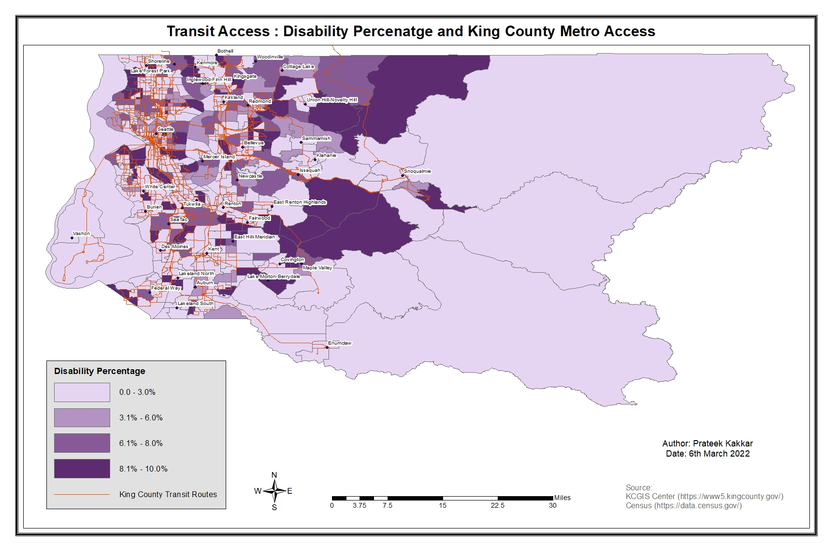
Disability Percentage and Transit Access

Slide 6
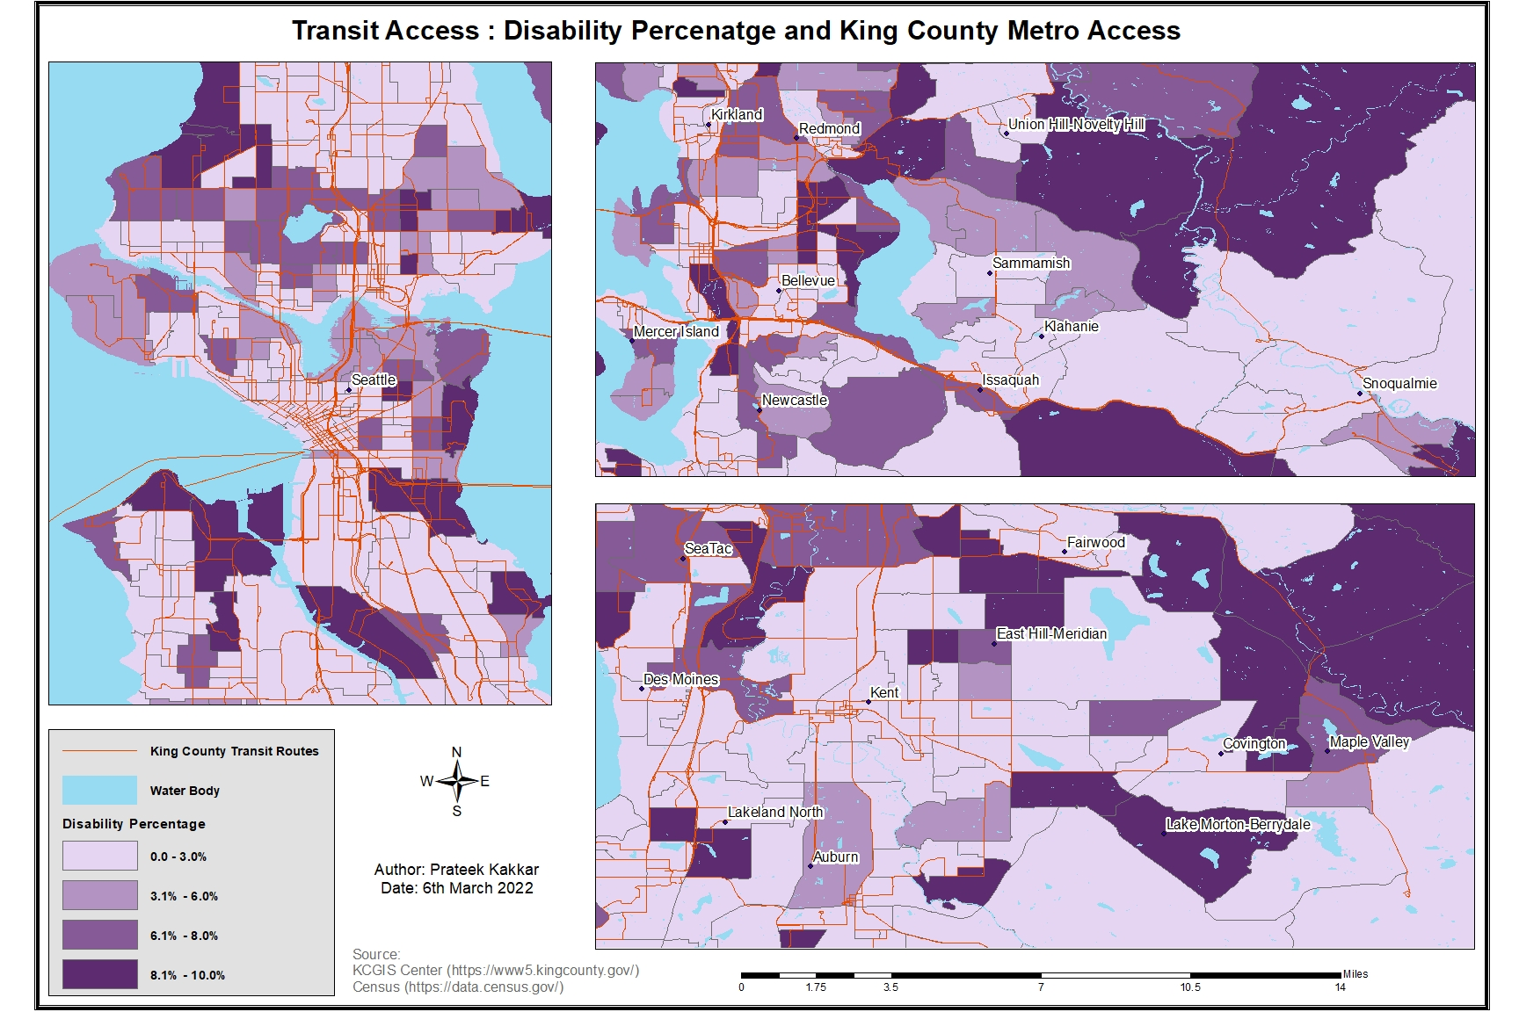
Disability Percentage and Transit Access

Slide 7
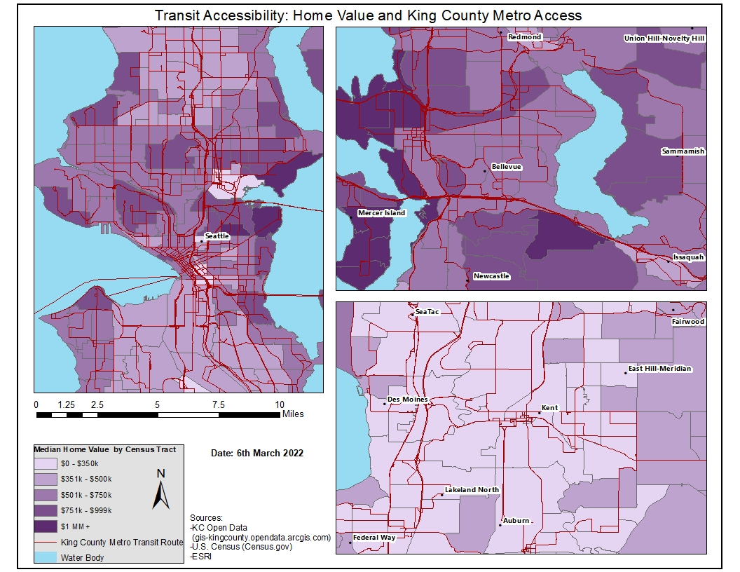
Home Values and Transit Access

Slide 8
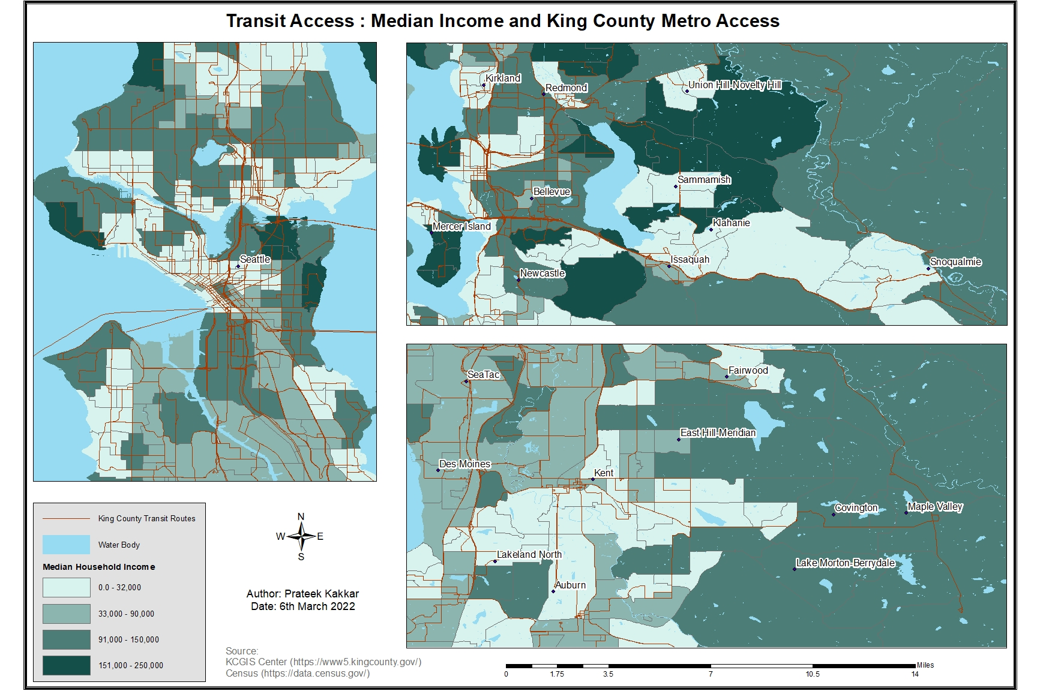
Median Income and Transit Access

Slide 9
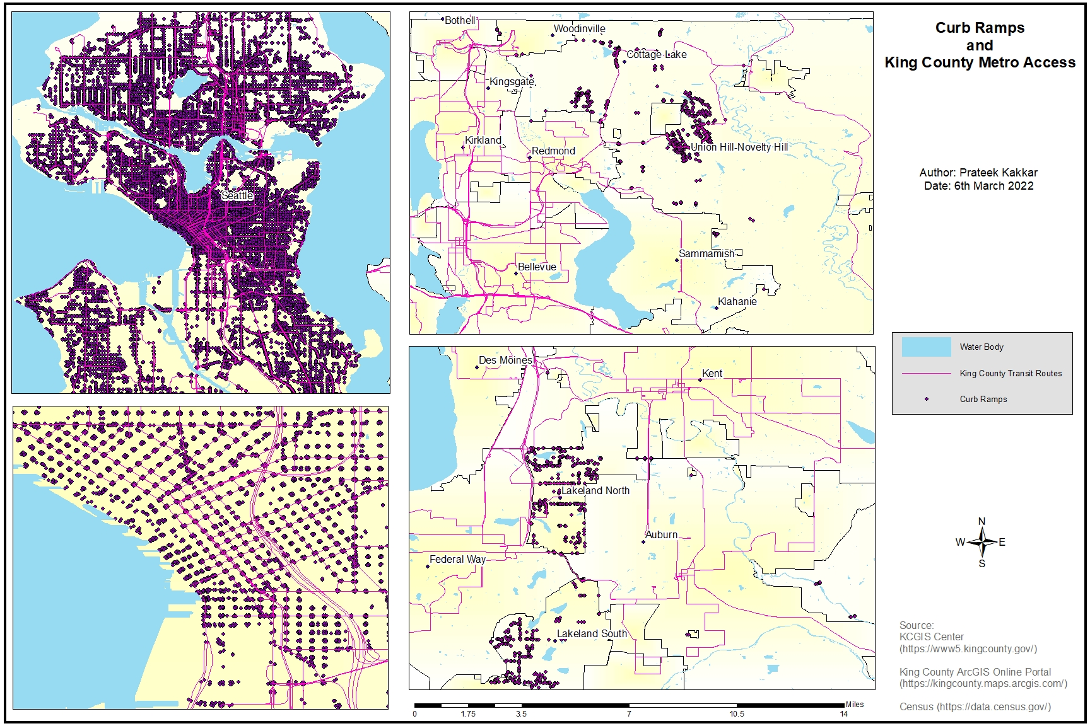
Curb Ramps in Major King County Cities

Slide 10
Conclusions
Results of Hypothesis: Accepted!
King County transit routes are heavily located away from affordable housing, primarily congregated near businesses in Seattle and other major King County cities.
Other Relevant Results and Recommendations:
Eastern and Northern King County are almost entirely devoid of access to transit, even in areas such as Sammamish and Woodinville with a higher disability percentage and income level.
Higher income level only increases access to transit if living near a major shopping center or business hub.
Disabled persons who need access to curb ramps for safe transit access are even further limited in their accessibility, limited almost entirely to the city of Seattle within King County.
Finding are congruent with research performed by other studies in other major metropolitan areas (Kramer, 2018).
Notes:
Even cities like SeaTac and Des Moines lack almost any major public transportation other than airport routes in SeaTac and on demand services.

Slide 11
Sources and References
Brumbaugh, S. (2018, September). Travel patterns of american adults with disabilities. Bureau of Transportation Statistics. https://www.bts.gov/sites/bts.dot.gov/files/2022-01/travel-patterns-american-adults-disabilities-updated-01-03-22.pdf
Kneebone, E. (2017, February 15). The changing geography of US poverty. Brookings Institute. Retrieved February 1, 1992, from https://www.brookings.edu/testimonies/the-changing-geography-of-us-poverty/
Kramer, A. (2018). The unaffordable city: Housing and transit in North American cities. Cities, 83, 1–10. https://www.sciencedirect.com/science/article/pii/S0264275117310855
Puget Sound Regional Council. (n.d.) Opportunity mapping. Retrieved February 1, 2022. https://www.psrc.org/opportunity-mapping
Stacy, C., Su, Y., Noble, E., Stern, A., Blagg, K., Rainer, M., & Ezike, R. (2020, October). Access to opportunity through equitable transportation: Lessons from four metropolitan Regions. Urban Institute. https://www.urban.org/research/publication/access-opportunity-through-equitable-transportation/view/full_report
US Census Bureau. (2021, November 21). How disability data are collected from the american community survey. Census.Gov. Retrieved February 1, 2022, from https://www.census.gov/topics/health/disability/guidance/data-collection-acs.html

